Slide 1
COSUAA Annual Conference
Development & Fundraising in Enrollment Management and Financial Aid
Roger J. Thompson
Vice President, Student Services and Enrollment Management
University of Oregon
San Diego, California
April 2022

Slide 2
University of Oregon Overview
Public, flagship university founded in 1876
Member of the Association of American Universities (AAU)
Enrolling approximately 22,500 students.
Located in Eugene, Oregon with satellite campuses in Portland, Oregon, the Oregon Coast, and an observatory in Pine Mountain, Oregon.
Mascot is the Oregon Duck

Slide 3
Student Services and Enrollment Management Overview
1,700+ team members
Full time, part time, student assistants, including union represented
192,000,000 organizational budget
Including 62,000,000 institutional financial aid budget
Eleven distinct departments including central SSEM administration
3 auxiliary units
Led and administered by an associate vice president, and six assistant vice presidents

Slide 4
Student Services and Enrollment Management Overview
Continuing and Professional Education
Office of Admissions
SSEM Events Office
University Health Services
University Housing
Office of the Registrar
Office of Student Financial Aid and Scholarships
Student Orientation Programs (including campus visits)
SSEM Strategic Communications and Marketing
University Testing Center
Central SSEM Administration.

Slide 5
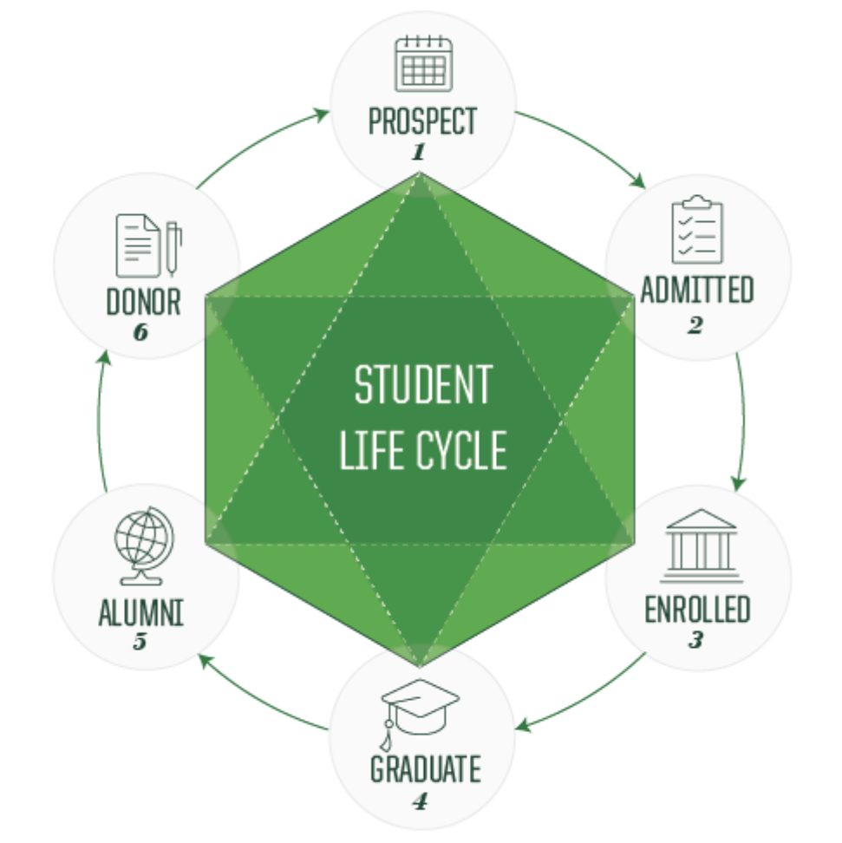
Student Lifecycle

Slide 6
Origins of Fundraising for Scholarships
University of Oregon was preparing to launch the largest fundraising campaign in the history of the university and state.
Strong partnership was already established with Vice President for Advancement.
Initial campaign priority identification had been focused on capital projects, academic initiatives, new initiatives and athletics.
Campaign goal was established at $2,500,000,000.

Slide 7
Origins of Fundraising for Scholarships
Given the importance of the campaign, it was critical SSEM be involved in the top priority of the university.
Important we link our enrollment goals to the campaign and scholarships.
SSEM needed to bring resources to the discussion.
Desire was for SSEM to be viewed similarly to an academic college or school.
Utilized credibility in other areas to demonstrate commitment to the fundraising goals and targets.

Slide 8
Fundraising for Scholarships
Commitment from Vice President for Advancement to enable and empower SSEM to contribute.
Established a scholarship goal for SSEM ($70,000,000).
Established an FTE under the “campaign cost share agreement.”
50% from the unit, 50% from Advancement.
Hired our first SSEM based fundraiser.
Partnered with Clark Honors College and worked collaboratively.

Slide 9
Fundraising Goal
Goal was to raise $70,0000000,000 by conclusion of the campaign.
Result: Raised $118,000,000.
Exceeded the goal by 69%.

Slide 10
Enrollment Accomplishments
Increased the entering class size by 39% from the prior ten year average.
Increased under-served and under-represented populations from 17% to 34% of the entering class.
Increased the entering class average high school gpa from 3.5 to 3.73.
Increased the discount rate from 10% to 12%.

Slide 11
Discussion
Roger J. Thompson
Vice President for Student Services and Enrollment Management
University of Oregon
Email: rjt@uoregon.edu
Phone: 541-346-2541

